Slide 1

Modelling a Battery as a Complex System
By Sanjif, Peter, Connor

Slide 2
Contents
The problem - Connor
Modelling the problem - Peter
Solving the problem - Sanjif

Slide 3

Charge is a FORCE, energy (Joules) is not the same as charge (Coulombs). A Volt is the energy per unit charge
7.774×10^22 Lithium ions have a collective charge of 12455.31 Coulombs
To produce an electromotive force of 3.6 Volts of energy from the batteries charge requires an energy difference in a charged battery of 44839.11 Joules
As 1mAh = 3.6 Coulombs, the battery has a capacity of 3459.8mAh which is the total current over time that can be drawn from the battery at 3.6 Volts
+
+

Slide 4
Why not Li-ion?
They can overheat and explode.
They have low self-discharge, where chemical reactions inside the battery cause it to lose charge without it being connected to anything
They have a high energy density

Slide 5

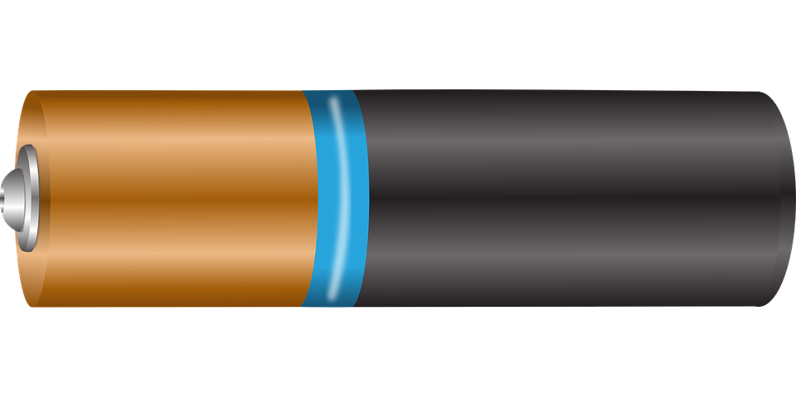
Irreversible damage equations
Cobalt oxide synthesis
LiCoO₂ ⟶ Li⁺ + CoO₂ + e⁻
Lithium oxide synthesis
LiCoO₂ + Li⁺ + e⁻ ⟶ LiO₂ + CoO
Over Charging
Over Discharging

Slide 6
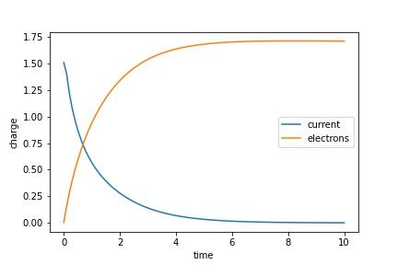
Current graph @ 4.2V

Slide 7
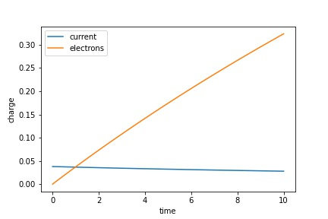
Current vs Time for an uncatalysed reaction
Ideally, the reaction is catalysed when voltage hits a threshold, the current decays exponentially.

Slide 8
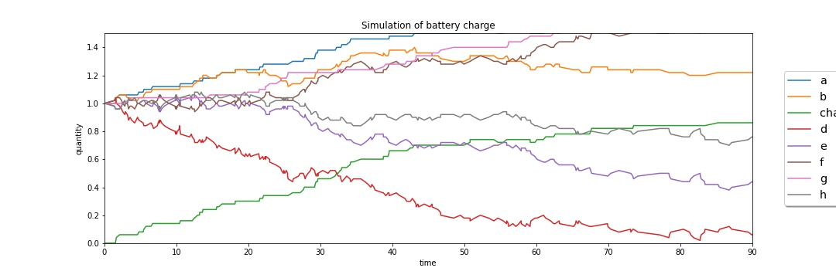
Gillespie algorithm for stochastic solution of the system of equations.

Slide 9
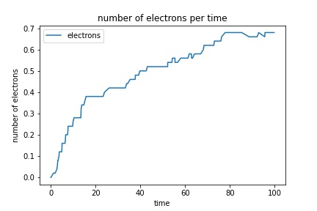
Modelling electrons stochastically

Slide 10
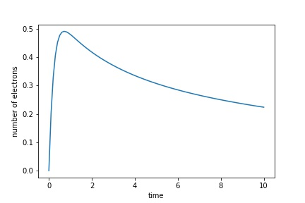
When the irreversible equation takes over
The number of electrons hit a critical point, then decrease exponentially.

Slide 11
Constant Charge - Constant Voltage charging
This gif shows the CC charging profile. The variable supply fixes the current supply to the cell. Note the phase ends when the upper limit of voltage is reached. However, the capacity of the cell (area under red curve) is not the maximal capacity of the battery. Hence, we continue charging, moving to the next stage of the process

Slide 12
Constant Charge - Constant Voltage charging
This is the CV charging profile. The variable supply fixes the voltage supply to the cell. Note voltage and current have an inverse relationship. The phase ends when the lower threshold of limit of current is reached. The capacity of the cell (area under red curve) is not the maximal capacity of the battery but is close. Therefore we stop charging.

Slide 13
Charging profiles
Note the CC-CV charging profile is the standard strategy. However, there are multiple other strategies which may be better, depending on the requirements. For example:
Boost Charge, Constant Current - Constant Voltage (BC-CC-CV)
Multistage current charging (IPPL-CC-CV)
The above profiles are variants of the CC-CV profile, with the current and voltage held fixed at different intervals

Slide 14
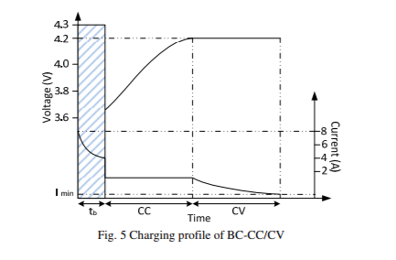
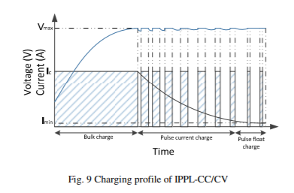
Charging profiles alternatives

Slide 15

How will we do this?
Constant Current
Constant Voltage

Slide 16
How will we do this? (please note the slides from here onwards are outdated - refer to pdf)
We consider n charging cycles with a variable charging profile. The maximum time allowed for a charging cycle is taken to be 5 hours split into 1 minute chunks (300 data points). We aim to minimise the time taken for n charge cycles while minimising any damage done to the battery, promoting battery longevity.
Battery Lifespan is reduced as a result of:
Over-discharging the battery (when max charge voltage (4.2V) is exceeded)
Under-charging the battery (when min charge voltage (3V) is exceeded)
Lithium Oxidation (therefore less electrons can be liberated at the anode)
Heat (high Temperature, and steep rate of change of heat)
The reward function of the genetic algorithm will look something like this
Reward = f(num_charges = n, time, over-discharge penalty, under-discharge penalty, oxidation penalty, heat penalty)
The algorithm uses the Gillipsie algorithm to return the start and end point values for (current, voltage, heat, electrons, lithium lost) across each interval. It will return a charging profile optimising the battery charging time while minimising degradation. We compare this to standard charging protocol.

Slide 17
Genetic Algorithm Pseudocode
Generate num_pop charging profiles, formatted as an array of bits where 0 represents CC and 1 represents CV. For example (0, 1, 0, 1, 0, 0, …..) represents (CC, CV, CC, CV, CC, CC) Each input represents a fixed time interval.
For each strategy profile calculate the fitness function and sort the strategies in decreasing order of fitness.
For the top 0.25 * num_pop charging profiles, crossover and mutate
Generate 0.75* num_pop random strategies to the profiles from (3.)
Repeat steps 1 - 3 for num_epochs.

Slide 18
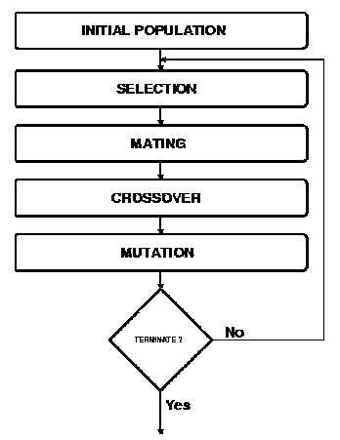

Slide 19
